Slide 1

Parking Lot System
Submitted by:Lav Singh(21ucs116@lnmiit.ac.in)

Slide 2

Introduction to System
Overview
This is a Java-based parking lot management system that simulates the parking and retrieval of vehicles. The system supports multiple floors and different vehicle types, including bikes, cars, and trucks.

Slide 3

Features
Create
Create a parking lot with a specified number of floors and spots per floor.
Park
Park vehicles (Bike, Car, Truck) based on availability.
Leave
Remove vehicles from the parking lot.
Availability
Check parking availability per floor and overall.
Locate
Locate parked vehicles by license plate.
is_full
Check if the parking lot is full.
Manage
Manage concurrent parking and retrieval using locks.

Slide 4
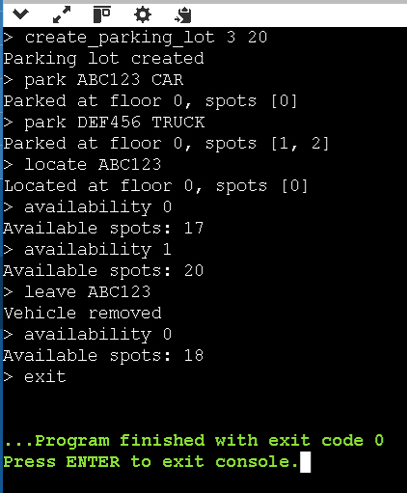
Terminal

Slide 5
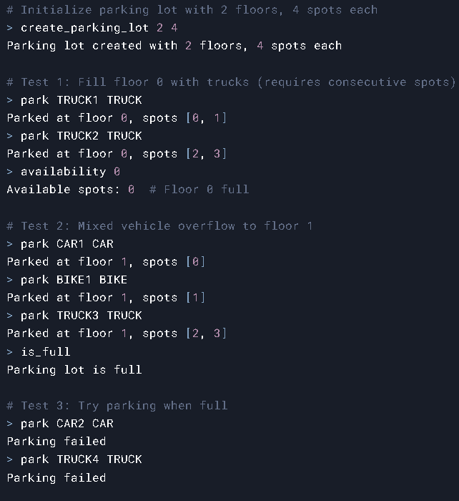
Terminal

Slide 6
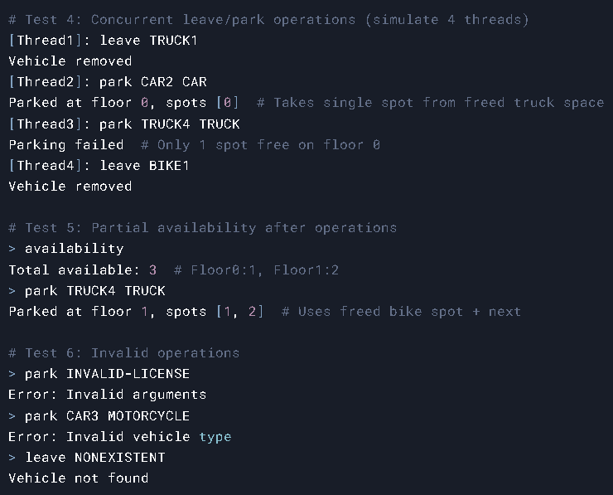
Terminal

Slide 7
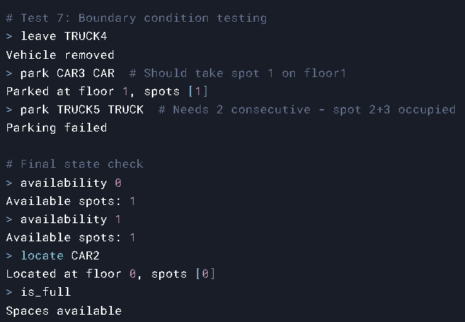
Terminal

